Slide 1
Energiebericht 2050
Fiktiver Bericht zur Energieversorgung 2050

Slide 2
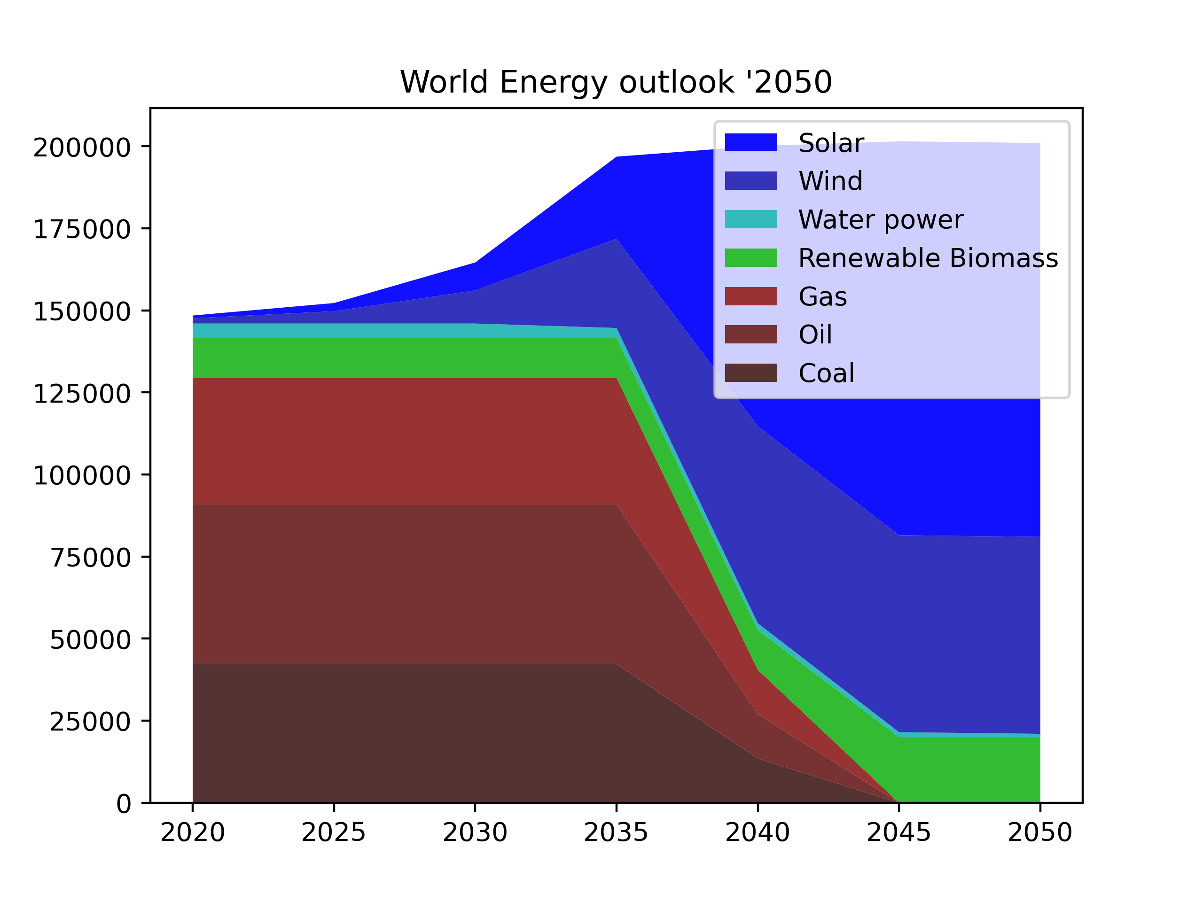

Slide 3
Solar energy
Is going to be really, REALLY cheap
In aride deserts very reliable
  --> the only source; no storage required; very cheap
Where people live not so reliable due to weather
--> Diversification of risk (wind, biomass)
  Land usage conflicts --> not so cheap

Slide 4
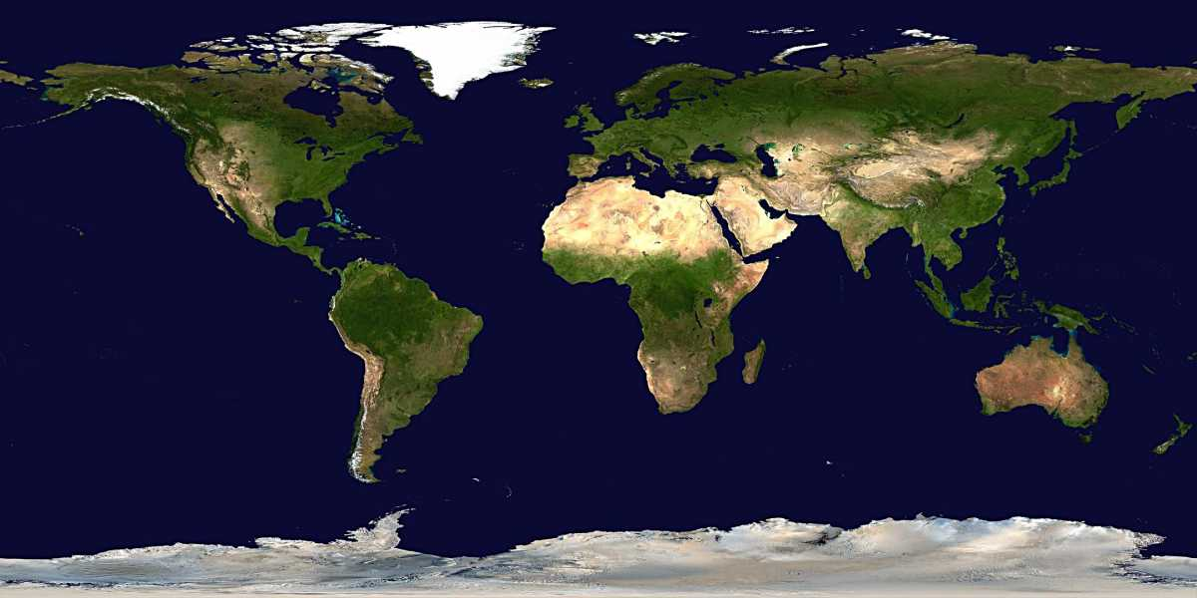
Solar energy – arid land

Slide 5
How to store energy
Multiple methods exist:
None (consume directly)
Batteries
Hydrogen, Biomass, Thermal

Slide 6
Hydrogen and PtL
Hydrogen is NOT an energy source !!!
Hydrogen is difficult to deal with
PtG (Power to Gas) is dangerous (explosions)
PtL (Power to Liquid) has CARBON bottleneck
Bottleneck in PtL is CARBON !!!
--> Actually, PtL is "how to liquify biomass" ("reforming")
Anyways, only relevant after 2035 or so, when oil stops.
Oil infrastructure only makes sense if you consume a lot of it.

